Slide 1
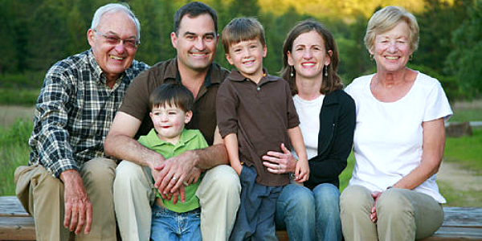
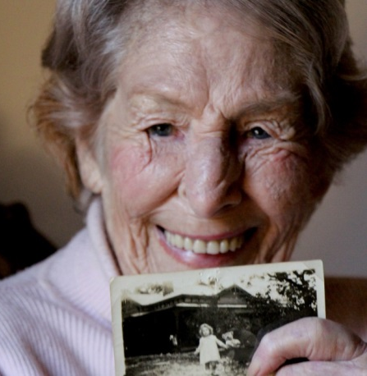
GENEROSITY No More One-Size-Fits-All
The Rev. Karl Travis
Pastor, First Presbyterian Church
Fort Worth, TX
Notes:
Why and how I got into generations theory …
Westminster, 80% over 65
“That’s the problem with your generation”
“Hey, don’t harsh my gig so hardcore, crustycakes”
Break into small groups, by generation, asking

Slide 2
Generations Theory
4 Types of Generations
Civic – a generation of cooperative leaders, team players, and institution builders. Work hard at developing collective unity and purpose.
Adaptive – a generation of cooperative followers. Team players, but not leaders by nature. They maintain and support the institutions their parents have built.
Idealist – a generation of prophets, committed to critiquing and reforming institutions and the broader culture. For idealists, individual identity comes before corporate belonging.
Reactive – a generation of under protected children and youth, they react to the idealists’ social critique and plot the course towards a new social cohesion.
Notes:
Presentation of basic theory
4 types of generations:
Repeating in near sequence
Shaped early in our lives a we experience same external events at similar developmental stages
By learning the patterns of past, we anticipate the future
Biblically, history is a line, and a circle – a spiral
Standard disclaimer
No attempt to put people in boxes
Some will fit neatly, others not
Fun to see what ways this describes you and your family
Explains groups of people, not individuals
Sociology, history, not psychology
Bibliography

Slide 3
Generations Theory
4 Types of Generations
Civic
Adaptive
Idealist
Reactive
These types of generations have repeated in the same order, with one exception, through U.S. history.
We develop natural ease with those who experience the same formative events at similar developmental stages.
In understanding the past, we anticipate the future.
Biblically, history is a line, and a circle -- a spiral.
Notes:
Presentation of basic theory
4 types of generations:
Repeating in near sequence
Shaped early in our lives a we experience same external events at similar developmental stages
By learning the patterns of past, we anticipate the future
Biblically, history is a line, and a circle – a spiral
Standard disclaimer
No attempt to put people in boxes
Some will fit neatly, others not
Fun to see what ways this describes you and your family
Explains groups of people, not individuals
Sociology, history, not psychology
Bibliography

Slide 4
The Living Generations
Generation Birth Years Generation Type
GI Generation 1901-1924 Civic (hero)
Silent Generation 1925-1942 Adaptive (artist)
Boomer Generation 1943-1960 Idealist (prophet)
Thirteener (Xer) Generation 1961-1981 Reactive (nomad)
Millennial Generation 1982-2004 Civic (hero)
Homeland Generation 2005-present Adaptive (artist)
Neil Howe and Bill Strauss, Generations: The History of America’s Future, 1584 to 2069. Quill: New York, 1991, and http://www.lifecourse.com/.
Notes:
Upon their return, have each group present their own newsprint. --
This slide can remain up the entirety of the group review …

Slide 5
What Formed Your Generation?
Instinctively, we know the answer …
Generations formed early in lifecycle
Generations formed by
historical events Where were you when?
technological developments Model Ts and The Walkman
cultural trends sex, drugs, rock and roll

Slide 6
Generations Theory and Organizational Life
Assumptions
There are certain tasks the church must simply do.
The strongest churches maximize the number of people doing them.
Different generations are motivated to do them in radically different ways.
GIs
Silents
Boomers
13ers
Committees
Duty
Obligation
Necessary evil
Uninterested
Committee structure
Stable, consistent, traditional. New members encouraged to find their way in the existing system.
Stable, consistent. Again, newcomers mold themselves into the existing structure.
Impatient with institutional obstructions. Committee structure must be responsive and flexible.
Unmotivated to participate in existing structure; “fitting in” less important than discerning and offering individuals’ gifts.
Traditional organizations
(mens/womens groups, Sunday school)
Participation counted as a significant measure of identity and faithfulness
Same as GIs, with a tinge of sadness if not guilt at watching them wither
Largely uninterested, even if organization withers and dies
Largely unaware that these organizations exist; unwilling to participate to perpetuate organizations they do not know or understand
Vestry
To be included is an honor and sign of prominence in church/community
To be included is an honor and sign of prominence in church/community
Cynicism of power structures brings critique to groups’ activities and tasks.
Rarely included and largely unaware except insofar as they secretly resent having to have permission to follow their own visions.

Slide 7
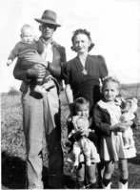
GI and Silent Generations
Early experiences of money and stewardship
Trained from childhood
Nickels/Dimes in the milk box
Fruit Fruits givers
Likeliest to be pledgers
Likeliest to be tithers
Giving is a public responsibility, a necessity

Slide 8
Baby Boom & 13er Generations
Early Experiences of Money
Post war economic boom
Upward mobility
Television advertising (redefined scope of perceived affluence)
Rapid growth of stock market
Growing disparity between rich and poor

Slide 9
Baby Boom & 13er Generations
Early Experiences of Stewardship
Spotty stewardship training in mainline congregations
Many come from unchurched backgrounds, so stewardship is a new conversation
Taught that giving is a personal option, personal possibility, not public necessity

Slide 10
GI and Silent Generations
Attitude Toward the Institutional Church
High level of trust and participation
Church mirrored, and symbolized, the established order
Church is repository of inherited faith, entrance into social belonging
Yet, in later years, the church was not above critique

Slide 11
Baby Boom & 13er Generations
Boomer Attitude Toward Institutional Church
Distrust, if not disgust
Skeptical of stewardship is presented about the institution’s health. Money does not follow mission for Boomers
Hold little denominational loyalty

Slide 12
Baby Boom & 13er Generations
13er Attitude Toward Institutional Church
Not constitutionally anti-institutional
Will trust a congregation if it “works,” i.e. does what it says it’s going to, and tells the truth
Looking for a community, not church, in which to practice spiritual disciplines

Slide 13
GI and Silent Generations
Meaning of Money
money = security
Stewardship Descriptor
GIs: sacrifice
Silents: commitment
Money Follows Mission

Slide 14
Baby Boom & 13er Generations
Meaning of Money
Money = tool
Stewardship Descriptor
Boomers: distrust
13ers: ignorance
Mission Follows Money

Slide 15
Baby Boom & 13er Generations
Making Faithful Boomer & 13er Stewards …
Earn trust
Provide control in giving
Provide choice in giving
Educate: many Boomers began faith journey in a time when our congregations didn’t teach stewardship

Slide 16
Baby Boom & 13er Generations
Making Faithful Boomer & 13er Stewards …
Reinterpret, reframe stewardship
Make it holistic. Stewardship is a lifestyle.
2. It’s about individual’s need to give, NOT church’s need to receive.
3. Stewardship is a spiritual discipline, alongside other disciplines: Bible study, worship, prayer, service.

Slide 17
Baby Boom & 13er Generations
Making Faithful Boomer & 13er Stewards …
Challenge the conflation of want and need.
Model sacrifice. The congregation which doesn’t give to mission off the top has no moral right to ask its members to

Slide 18
Millennials
Early Experiences of Money
9/11
Perpetual presence of war
Barrage of advertising (5,000 advertising impressions per day)
Education debt larger than consumer debt
Even greater disparity between rich and poor

Slide 19
Millennials
Millennial Impact Report (Case Foundation)
Millennials …
prefer to connect via technology.
share in micro ways. (Interactions are immediate and impulsive.)
facilitate (and rely on) peer influence.
volunteer along a continuum of support. (They begin with single volunteer experiences and their support for the organization grows.)
give to have an impact. (Cause versus organization.)

Slide 20
Have we been doing the wrong thing, really well, for the last 30 years?

Slide 21
Common Steps in a
Stewardship “Campaign”
Vestry projects coming year’s budget (may be rough draft)
Interprets budget to the parish
Newsletter articles, Minutes for Mission, letters, brochures
Rector preaches motivational stewardship sermon on single stewardship Sunday
Pledge Cards toward coming year’s budget circulated by
US mail
Available in the Narthex
Pony Express or other house to house system
Pledge Cards returned by due date
Vestry totals pledge cards, adjusts budget, dedicates pledges in worship
Following year, process repeated

Slide 22
“Campaign” for Whom?
Inspires Boomers/ 13ers/
Millenials
Inspires
GIs/ Silents
Vestry projects coming year’s budget (may be rough draft)
Interprets budget to the parish
Newsletter articles, Minutes for Mission, letters, brochures
Pastor preaches motivational stewardship sermon on single stewardship Sunday
Pledge Cards toward coming year’s budget circulated by
US mail
Handed out in church
Pony Express or other house to house system
Pledge Cards returned by due date
Vestry totals pledge cards totaled, adjusts budgets, dedicates pledges in worship
Following year, process repeated
✓
✓
✓
✓
✓
✓
✓
✓

Slide 23
Money Cross Talk for All Generations:
A Miscellany
Talk about God, then the believer, then the Church … in that order.
Emphasize individual's need to give, not church's need to receive.
All stewardship rooted in thanks-giving. Generosity is born in gratitude.
Make it easy to give by receiving electronic funds transfers (and a word about credit cards)

Slide 24
Money Cross Talk for All Generations:
A Miscellany
Reverse the budget equation.
Pledges produce budget; budget doesn’t attract pledges
Use narrative budgets
Provide opportunities for faith speaking.
Personal faith sharing (Every Member Visitation?)
Testimonials in worship

Slide 25
Money Cross Talk for All Generations:
A Miscellany
Earn Trust – walking the walk.
PPP: Publicly Promise to Pay mission commitments first
Transparent Treasury: Regular financial statements in public places and systematic reporting of need AND expenditure
For leaders, especially priests: SHARE that you give, what you give, and why

Slide 26
Money Cross Talk for All Generations:
A Miscellany
In the annual stewardship effort, target the message, design the experience.
Multiple mailings, generationally specific
Generationally sensitive brochures, letters, and appeals

Slide 27
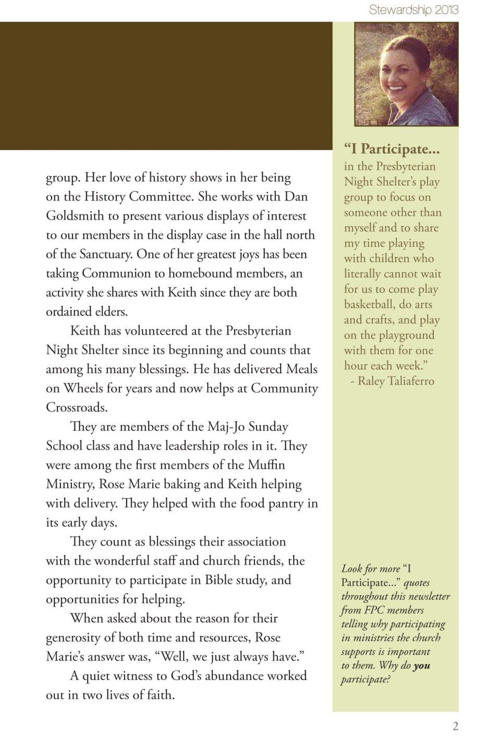

Slide 28
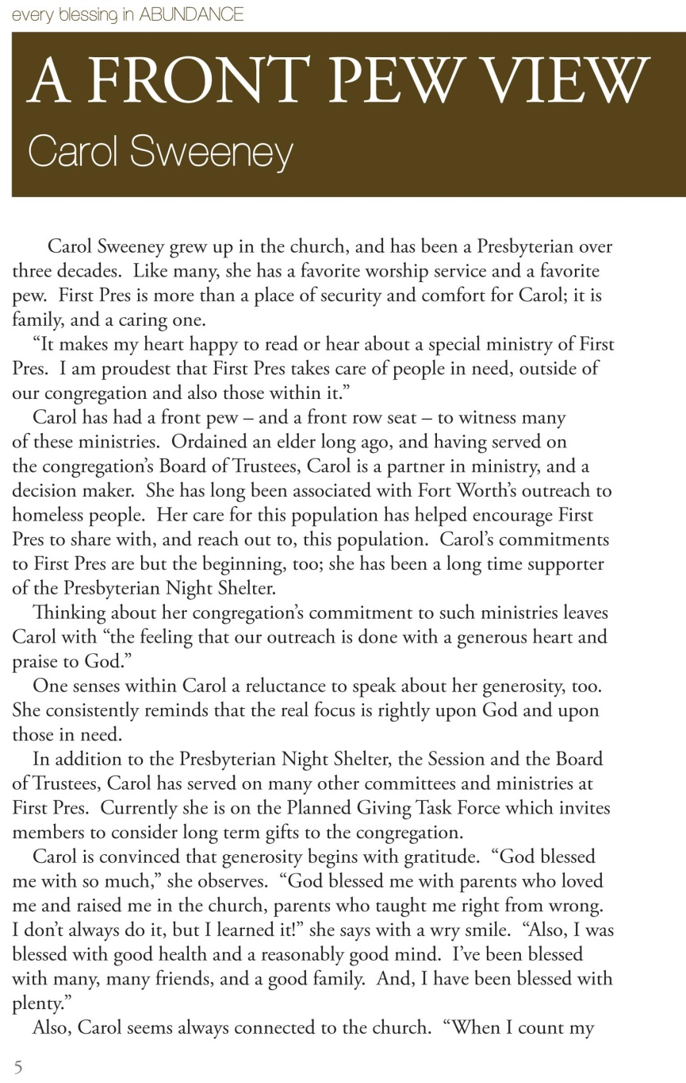
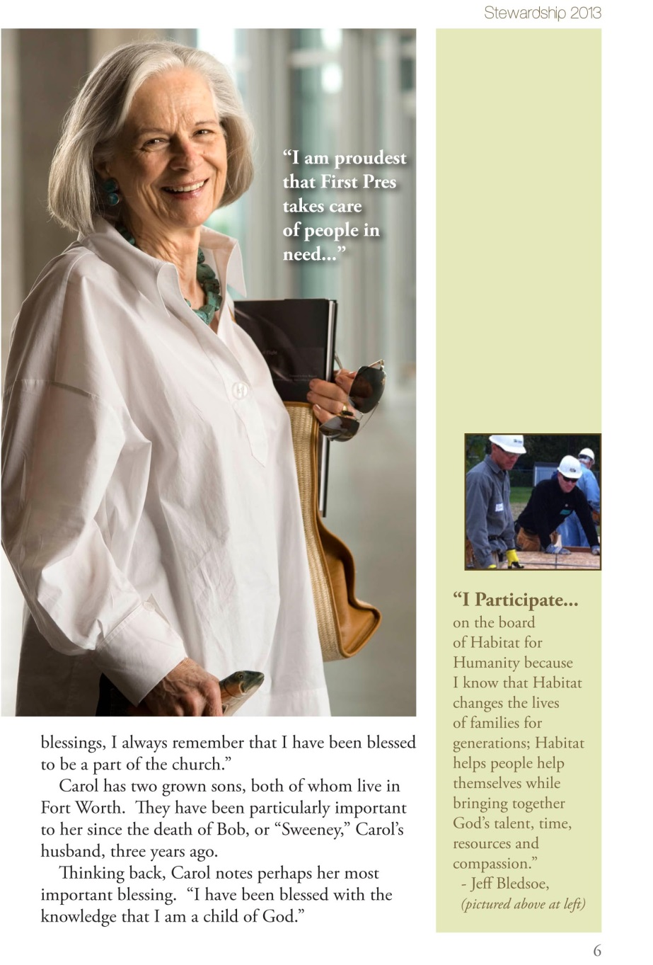

Slide 29
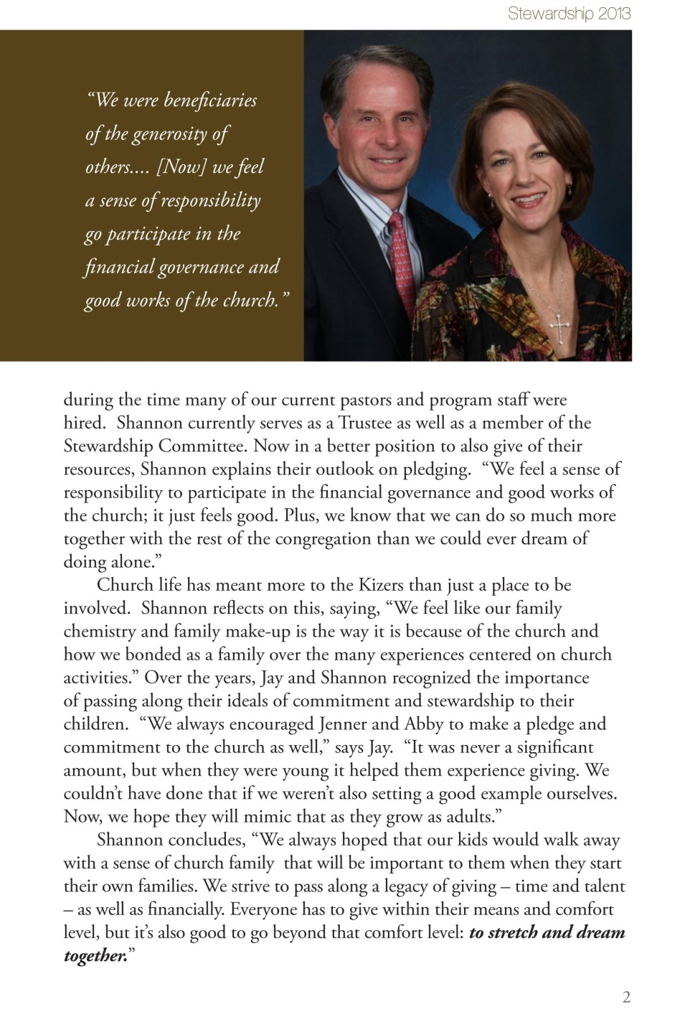
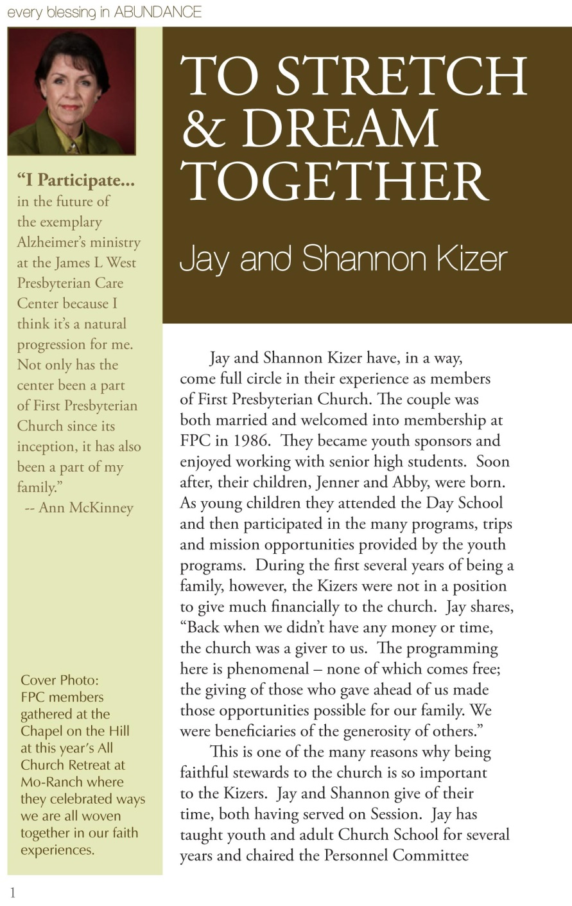

Slide 30
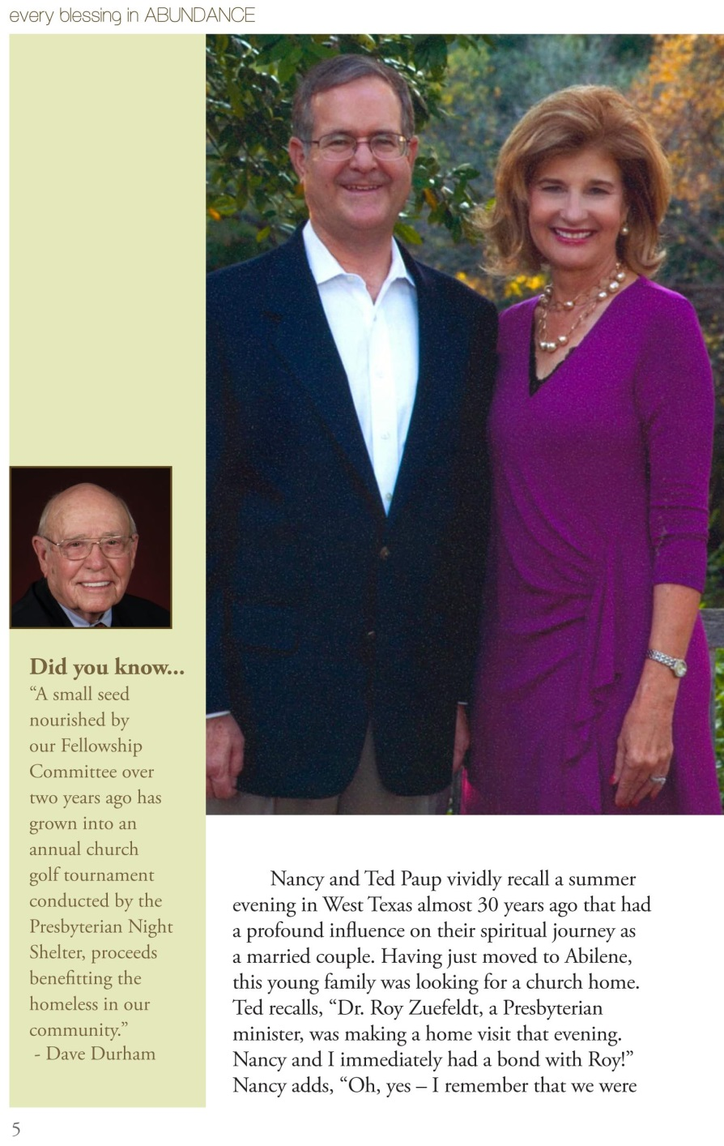
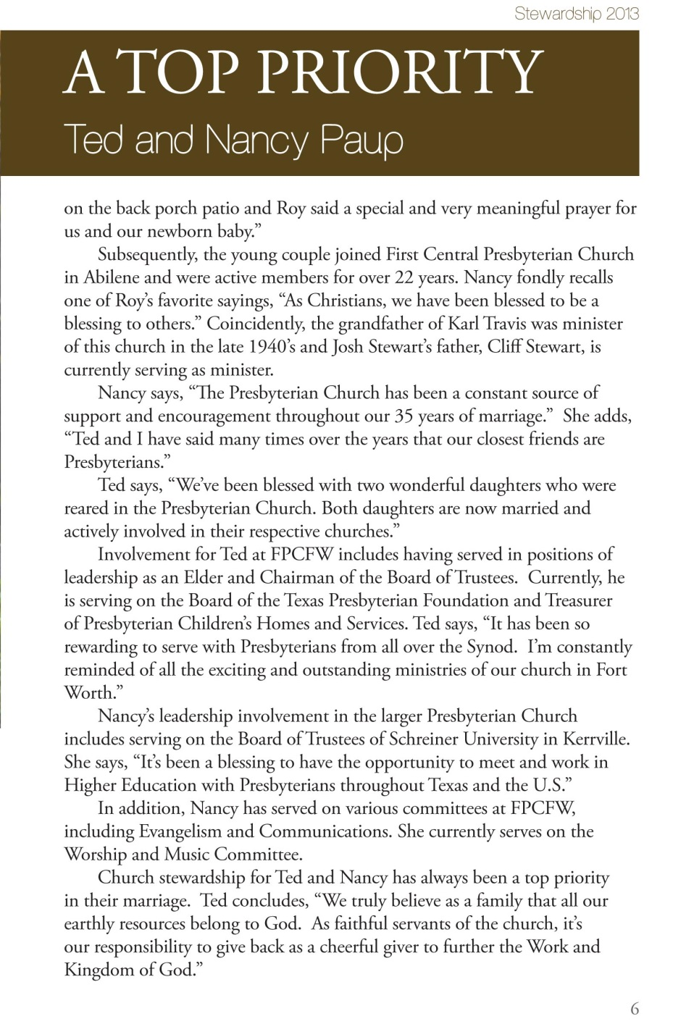

Slide 35
First Presbyterian by Generation
May 2014

Slide 38
GENEROSITY No More One-Size-Fits-All
The Rev. Karl Travis
Pastor, First Presbyterian Church
Fort Worth, TX
Notes:
Why and how I got into generations theory …
Westminster, 80% over 65
“That’s the problem with your generation”
“Hey, don’t harsh my gig so hardcore, crustycakes”
Break into small groups, by generation, asking

